Slide 1
7 Surefire Ways You Know Your Current “IT Guy” Is Secretly Failing You
This Free Business Advisory Report Will Show You:
If You’ve Outgrown Your Current “IT Guy”
If You’re Getting Overcharged By Your Current “IT Guy”
If It’s Time To Get A New "IT Guy”
If Your Current “IT Guy” Is Secretly Failing You
Provided as an educational service by: Keith Heilveil
Advantage Industries
6325 Woodside Ct. Suite 200 Columbia, MD 210416
www.getadvantage.com 443-319-4070

Slide 2
Introduction Finding an honest and capable computer consultant is a lot like finding an honest mechanic; they both operate in fields where the technician can easily rip off a client because they play on their customer’s lack of technical knowledge. The problem is that you won’t know you’ve hired the wrong consultant until you are halfway into your project and have already invested a considerable amount of time and money. Sometimes it’s not even that obvious. A consultant may look like they are doing a good job, but unless you are technically savvy yourself, you simply have no way of knowing if they have over-billed you or recommended technology that you could have lived without just to pad the bill a little. On the flip side, a good computer consultant will save your company a considerable amount of time, money, and frustration while increasing office productivity, lowering overall operation costs, improve customer service, and helping you avoid devastating data losses and viruses. That is why I’ve decided to write this paper. As a small business owner and consultant, myself, I want to arm other business owners with a few good pointers to help them avoid getting the short end of the stick when outsourcing any IT project or support. After all, your computer network is the nerve center of your business. It largely affects productivity, security, and even the competitive advantage of your organization. One bad decision can severely cripple an organization through lost productivity, data, or excessive costs.
Following are 7 surefire ways you know your current “IT guy” is secretly failing you. If any of these 7 tips resonate with you, you may end up:
Losing a considerable amount of money.
Find yourself facing hours of frustration that comes with making a bad decision.
Not actually be protected and covered like you think you are.

Slide 3
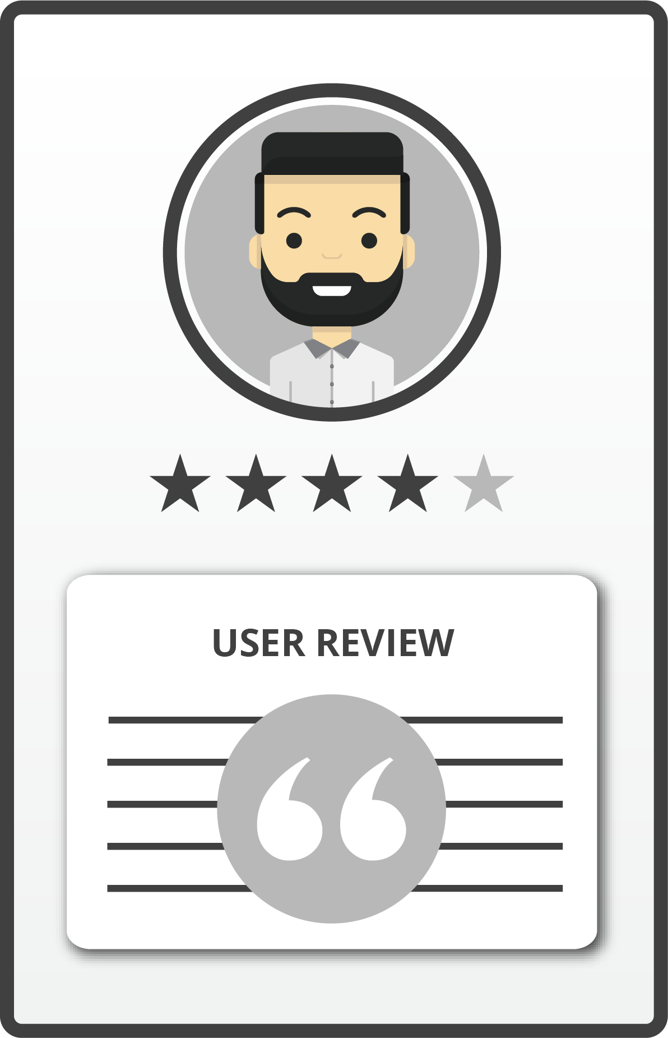
This is one area where I see a lot of companies getting burned. When most consulting companies quote a project, they give you an estimated cost for completion with an hourly rate added in for “unexpected events” that may arise during the project. This is often called “time and materials.” Be very careful about signing these contracts. A good consultant should be experienced enough to have thoroughly investigated your situation and thought through problems and issues that may arise before issuing a proposal. Adding on a clause where they can charge you for extra hours is a safety net for them. If their consultant screws up, takes longer than they should, or if they overlooked something when quoting the job, YOU end up paying the price. Next thing you know you’re well into the project and the bill ends up being twice as much as you expected.
#1: They Don’t Offer Fixed Pricing And Charge You Hourly
#2: They Don’t Have Recent Testimonials Or References That You Can Contact
This seems obvious, but a lot of companies skip over this step. Ideally, you want to speak to other clients who had a similar project or problem, but this isn’t always possible since every company’s network and computing needs are different. You do want to speak to a few recent clients to find out:
Did they deliver on what they promised?
Were they responsive and easy to get hold of in times of emergency?
Did they bill accurately?
Did they stay within the projected budget?
Would you use them again? Why or why not?
You might also ask if there were any problems that arose and how the consultant handled them. Not every project goes perfectly; that is why it’s important to find out how the consultant handles problems before you hire them. If your consultant seems hesitant to provide you with references, take that as a red flag.
To claim your free discovery call, please visit www.getadvantage.com/discoverycall
Or call our office at 443-319-4070.

Slide 4
A lot of businesses are reluctant to outline a complete high-tech project because they lack confidence in the area of technology, but we can’t stress the importance of this enough. Don’t be afraid to ask your consultant to explain the project in simple terms that are clear to you. Ask questions like, “Tell me why this is absolutely necessary” or, “What does that mean exactly?” or, “Explain to me exactly how this will work, once it is done, on a user level.” A good consultant will welcome these questions and be more than happy to answer them because it will eliminate a lot of disappointment and frustration for both of you. Doing this will help you avoid expensive misunderstandings that can pop up in the middle of a project and put you well over budget.
#3: They Don’t Provide A Clear, Detailed Contract With A Scope Of Work Insuring You With Paid Protection, Systems, And Software Before You Spend A Dime
Once you are clear on the result you want and how it is going to happen, get everything in writing to avoid confusion and disappointment further down the road. If your consultant feels that some goals are unachievable, then it is their responsibility to tell you so up-front. By getting them to put everything in writing you can hold them accountable for the promises they make and responsible for outcomes not achieved.
Here are the main details you want to agree to in writing:
Confirm payment terms. This includes up-front deposits, fee structure, and payments on completion of the project. Most consultants work with an up-front down payment, then percentages of the total cost to be paid as phases of the project are completed.
Deliverables. What do you expect to be able to do when the project is done? How should the workflow? What does it look like? Don’t assume anything; if you expect it to happen, get it in writing as specifically as possible.
Work schedule and pace. Make sure you outline a date for completion as well as the phases of delivery.
Again, any professional, experienced computer consultant will be more than happy to outline these items in writing prior to a project. If they hesitate or make excuses, it is a sign they are not confident in their ability to deliver on their promises.
To claim your free discovery call, please visit www.getadvantage.com/discoverycall
Or call our office at 443-319-4070.

Slide 5
One big mistake we see a lot of business owners make is hiring a very small one-man-band consulting firm or relying on someone who is supporting your network on the side (moonlighting). By doing this they think they are saving a lot of money because these individuals typically charge less than established computer networking firms. The challenge comes when they can’t respond to your emergencies or complete your projects on time because they have too many clients. Or they simply go out of business because they can’t make enough money leaving you high and dry. Basically, as with all things in life, you get what you pay for. If you have mission-critical applications and data that must be protected and working 24/7, then it makes sense to hire a well-established firm with a good track record and enough technicians on staff to quickly respond to any technical emergencies that arise.
#4: They Don’t Have A Team Of Experts That Can Help You, Or They’re A “One-Man-Band”
#5: They Don’t Respond Quickly To Your Problems
And Requests
Most IT firms offer a 60-minute or 30-minute response time to your call during normal business hours. Be very wary of someone who doesn’t have a guaranteed response time IN WRITING – that’s a sign they are too disorganized, understaffed, or overwhelmed to handle your request. A good IT firm should be able to show you statistics from their PSA (professional services automation) software, where all client problems (tickets) get responded to and tracked. Ask to see a report on average ticket response and resolution times.
Also, any good IT company will answer their phones LIVE (not voice mail or phone trees) and respond from 8:00 a.m. to 5:00 p.m. every weekday. But many CEOs and executives work outside normal “9 to 5” hours and need IT support both nights and weekends. Look for an IT firm with a GUARANTEED response time.
To claim your free discovery call, please visit www.getadvantage.com/discoverycall
Or call our office at 443-319-4070.

Slide 6
Good IT companies won’t confuse you with techno-mumbo-jumbo, and they certainly shouldn’t make you feel stupid for asking questions. All great consultants have the “heart of a teacher” and will take time to answer your questions and explain everything in simple terms. Not to mention, if an IT company doesn’t have any type of feedback system, they may be hiding their lousy customer service results. If they DO have one, ask to see the actual scores and reporting. That will tell you a lot about the quality of service they are providing.
#6: You’re Treated Poorly
#7: You Always Have Constant Problems And They Seem To Be More Reactive Than Proactive
When a client has a problem, a good IT company will open a ticket in their IT management system so they can properly assign, track, prioritize, document and resolve client issues. However, some IT firms force a client to log in to submit a ticket and won’t allow them to call or e-mail with a problem. This is for THEIR convenience, not yours. Trust me, this will become a giant inconvenience and thorn in your side. While a portal is a good option, it should never be your ONLY option for requesting support.
Also, make sure they have a reliable system in place to keep track of client “tickets” and requests. If they don’t, I can practically guarantee your requests will sometimes get overlooked, skipped and forgotten.
BONUS: Ask your computer consultant to let you or your staff get involved with the project so you can learn to be more self-sufficient and shave off billable hours.
One of the easiest ways to save money on technical support is by learning how to handle the many basic, routine computer support problems that arise in-house. That is why you want to be involved with any project being rolled out.
Many consultants or firms will want to keep you in the dark because the less you know, the more billable hours they can rack up on mundane tasks that could be handled in-house. Unless you just don’t want to get involved, we highly recommend this as a way to save a considerable amount of money on tech support.

Slide 7
We PROMISE to always strive to meet our First Response SLA’s! We will respond to Critical Tickets within 15 minutes! We will respond to High Tickets within 30 minutes! We PROMISE to always strive to have a LIVE PERSON answer the phone! So, You Don’t Have to Leave a Voicemail! We PROMISE to always be TRANSPARENT about what we’re doing and how we’re performing! You won’t have to guess at what we’re doing or if we’re meeting our promises. We PROMISE 100% SATISFACTION! Our 100% Satisfaction Guarantee! If at any point during the contract term the customer becomes dissatisfied with a contracted service provided by Advantage Industries, they may: Send a written notice to Advantage Industries corporate offices at 6325 Woodside Ct #200, Columbia, MD 21046 notifying Advantage of their dissatisfaction and the specific issues that need to be corrected. Then Advantage shall have sixty (60) days to correct those specified issues. If, after 60 days, Advantage is unable to correct the specified issues to the customer’s satisfaction, then the customer will be free to leave the contract without any penalty. In addition, Advantage will provide any assistance required to help the customer make the transition to a new provider as seamless as possible.
4 Promises We Make To Our Clients
That No Other Technology Firm Or
Consultant Would Dare To Make:
1
2
3
4

Slide 8
Would You Like To Set Up A Free Call With Us?
If you have any questions about what you read today, we’d like to answer them. On this call we can discuss your unique situation, any concerns you have and of course, answer any questions you have about us. If you feel comfortable moving ahead, we’ll schedule a convenient time to conduct our proprietary IT Security & Services Assessment.
This Assessment can be conducted 100% remotely with or without your current IT company or department knowing (we can give you the full details on our initial consultation call).
At the end of the Assessment, you’ll know:
Where you are overpaying (or getting underserved) for the services and support you are currently getting from your current IT company or team.
Whether or not your systems and data are truly secured from hackers and ransomware, and where you are partially or totally exposed.
If your data is being backed up in a manner that would allow you to recover it quickly in the event of an emergency or ransomware attack.
Where you are unknowingly violating specific data breach or compliance regulations.
How you could lower the overall costs of IT while improving communication, security and performance, as well as the productivity of your employees.
Fresh eyes see things that others cannot – so at a minimum, our free Assessment is a completely risk-free way to get a credible third-party validation of the security, stability and efficiency of your I.T. systems.
To claim your free discovery call, please visit www.getadvantage.com/discoverycall
Or call our office at 443-319-4070.

