Slide 1
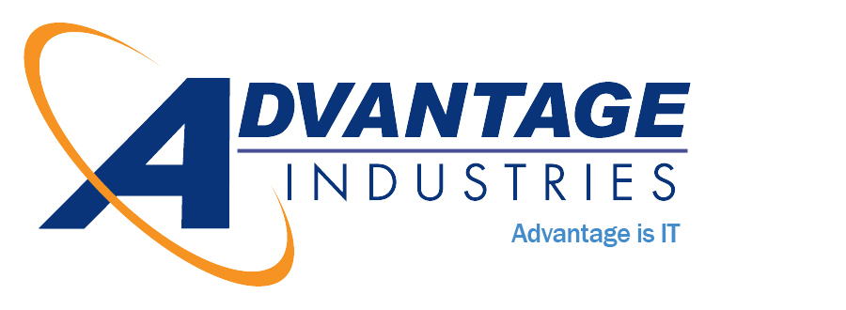
The Cybersecurity Crisis

Slide 2
The Small Business Cybersecurity Crisis
New And Critical Protections Every Small Business Must Have In Place NOW To Protect Their Bank Accounts, Client Data, Confidential Information And Reputation From The Tsunami Of Cybercrime And Ransomware
The growth and sophistication of cybercriminals, ransomware and hacker attacks has reached epic levels. CEOs can no longer ignore it or foolishly think, “That won’t happen to us.”
Your business – large OR small – will be targeted and will be compromised UNLESS you act on the information revealed in this shocking new executive report.
Provided as an educational service by: Keith Heilveil
Advantage Industries
6325 Woodside Ct. Suite 200 Columbia, MD 210416
www.getadvantage.com 443-319-4070

Slide 3
Keith Heilveil President, Advantage Industries Keith Heilveil is the President of Advantage Industries and a Maryland native. Keith is a veteran in the IT space with more than 24 years of experience fighting and preventing cybercrime. Over the years, Keith has worked with State and Federal Government agencies, and hundreds of businesses in numerous industries, ranging from small start-ups to a top 10 accounting firm. Advantage is now a full-service Managed IT Security & Services company with over 35 employees and 150 customers. Advantage’s focus is to protect its customers from today's advanced IT security threats, improve their operational efficiency, and provide their senior leadership with the technical insights they need to strategically run their business.
About The Author

Slide 4
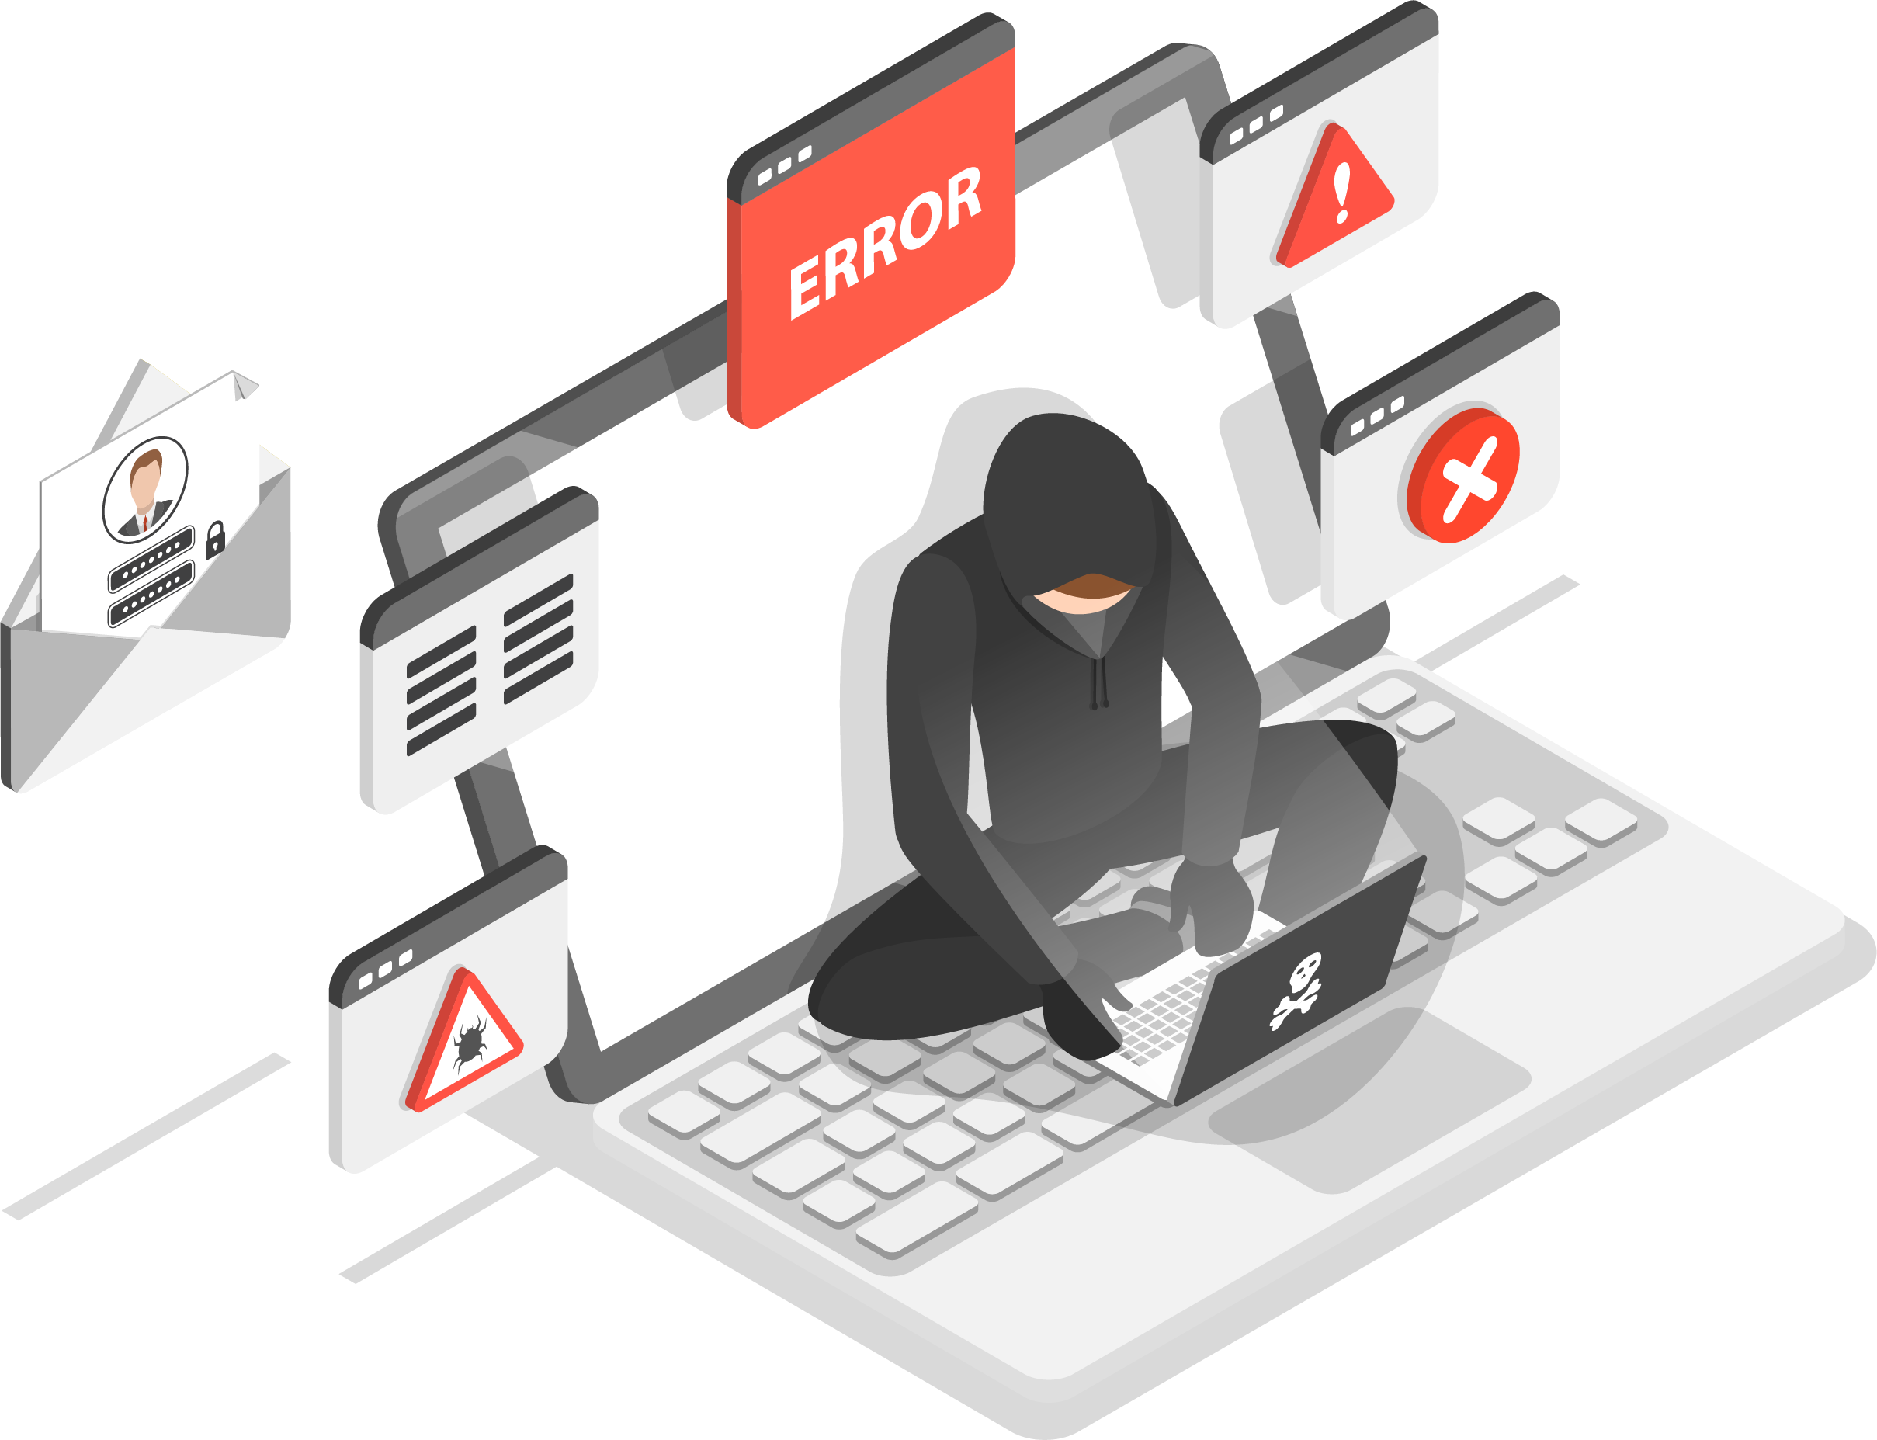
It’s EXTREMELY unfair, isn’t it? Victims of all other crimes – burglary, rape, mugging, carjacking, theft – get sympathy from others. They are called “victims” and support comes flooding in, as it should. But if your business is the victim of a cybercrime attack where client or patient data is compromised, you will NOT get such sympathy. You will be instantly labeled as “stupid” or “irresponsible.” You may be investigated, and clients will question you about what you did to prevent this from happening – and if the answer is not adequate, you can be found liable, facing serious fines and lawsuits EVEN IF you trusted an outsourced IT support company to protect you. Claiming ignorance is not an acceptable defense, and this giant, expensive and reputation-destroying nightmare will land squarely on YOUR shoulders.
When You Fall Victim To A Cyber-Attack By No Fault Of Your Own, Will They Call You Stupid…Or Just Irresponsible?
But it doesn’t end there… According to Maryland laws, you will be required to tell your clients and/or patients that YOU exposed them to cybercriminals. Your competition will have a heyday over this. Clients will be IRATE and leave in droves. Morale will TANK and employees will BLAME YOU. Your bank is NOT required to replace funds stolen due to cybercrime (go ask them), and unless you have a very specific type of insurance policy, any financial losses will be denied coverage.
Please do NOT underestimate the importance and likelihood of these threats. It is NOT safe to assume your IT company (or guy) is doing everything they should be doing to protect you; in fact, there is a high probability they are NOT, which we can demonstrate with your permission.
But first, please allow me to introduce myself and give you a little background on why I created this report.
Why We Are So PASSIONATE
About Informing And Protecting YOU
My name is Keith Heilveil, CEO of Advantage Industries. We specialize in being the outsourced IT Security and Services department for businesses in the Baltimore/Washington area. Over the last 24 years, we have seen the devastation that Cyber Crime can cause a business and have developed a Cyber Security program, based upon recognized industry standards that meets, or exceeds the requirements of most Cyber Insurance policies. In addition, we’ve developed a Cyber Insurance Compliance program, so that if a cyber event does happen you can prove that you’ve been complying with the insurance company’s IT Security requirements. You can go on Google and see the solid 5-start rating we have.

Slide 5
In the last couple of years, my team and I have seen a significant increase in calls from business owners desperate for help after a ransomware attack, data breach event or other cybercrime incident. When they call, they’re desperate, scrambling for anyone who can help them put the pieces back together again. Often their business is completely on lockdown. ALL their data has been corrupted or held for ransom, preventing them from fulfilling obligations they have to their clients. YEARS of work and critical data – all gone. They’re also scared and intensely angry. They feel violated and helpless. Embarrassed. How can money be taken from their bank account WITHOUT their permission or knowledge? Why didn’t their IT company or IT team prevent this from happening? How are they going to tell their clients/patients that they’ve exposed them to cybercriminals? They’re in complete disbelief that they fell victim – after all, they “didn’t think we had anything a cybercriminal would want!”
What makes this unforgivable is that ALL the CEOs coming to us for help after a serious attack had an IT company, they trusted with the responsibility of protecting the business, but realized all too late the company wasn’t doing the job it was PAID to do.
As a business owner, that boot-strapped my own company from the ground up. I know how hard you work to make your company succeed. I understand the risks you’ve taken, the personal sacrifices you’ve made. To me, it’s a GROSS insult to have it all taken away by some cyber-scumbag in a Third World country who will NOT be held accountable for his actions.
To make matters worse, so many so-called “IT experts” out there aren’t doing the job they were hired to do – and that truly angers me. As the CEO of a company, you’re FORCED to trust that your IT company or team is doing the right things to protect your organization – and when they fail to do their job, this expensive, devastating, business-interrupting disaster lands squarely on YOUR desk to deal with.
That’s why we’ve started a “one-company revolution” to educate and help as MANY business owners as we can so they never have to deal with the stress, anxiety and loss caused by a cyber-attack, and help you understand just how serious this is so you can be brilliantly prepared instead of caught completely off guard.
Yes, It CAN Happen To YOU And The Damages Are VERY Real
You might already know about the escalating threats, from ransomware to hackers, but it’s very possible you are underestimating the risk to you. It’s also possible you’re NOT fully protected and are operating under a false sense of security, ill-advised and underserved by your outsourced IT company.
Schedule Your Free, Cybersecurity Risk Assessment Today!
Visit www.getadvantage.com or call our office at 443-319-4070.

Slide 6
Don’t think you’re in danger because you’re “small” and not a big company like Experian, J.P. Morgan or Target? That you have “good” people and protections in place? That it won’t happen to you? That’s EXACTLY what cybercriminals are counting on you to believe. It makes you easy prey because you put ZERO protections in place, or grossly inadequate ones.
In fact, if they have not talked to you about the protections outlined in this report, or about putting a cyber “disaster recovery” plan in place, you are at risk and you are not being advised properly.
This is not a topic to be casual about. Should a breach occur, your reputation, your money, your company and your neck will be on the line, which is why you must get involved and make sure your company is prepared and adequately protected, not just pass this off to someone else.
QUESTION: When was the last time your current IT company had THIS conversation with you? What HAVE they told you about these new threats? If they have been silent, then I would urge you to read this report in full and act on the information urgently.
“Not My Company…Not My People…We’re Too Small,” You Say?
Right now, there are over 980 million malware programs out there and growing (source: AV-Test Institute), and 70% of the cyber-attacks occurring are aimed at small businesses (source: National Cybersecurity Alliance); you just don’t hear about it because the news wants to report on BIG breaches OR it’s kept quiet by the company for fear of attracting bad PR, lawsuits and data-breach fines, and out of sheer embarrassment.
In fact, the National Cybersecurity Alliance reports that one in five small businesses have been victims of cybercrime in the last year – and that number includes only the crimes that were reported. Most small businesses are too embarrassed or afraid to report breaches, so it’s safe to assume that number is much, much higher.
Are you “too small” to be significantly damaged by a ransomware attack that locks all your files for several days or more?
Are you “too small” to deal with a hacker using your company’s server as ground zero to infect all your clients, vendors, employees and contacts with malware? Are you “too small” to worry about someone taking your payroll out of your bank account? According to Osterman Research, the AVERAGE ransomware demand is now $84,000 (source: MSSP Alert). It’s also estimated that small business lost over $100,000 per ransomware incident and over 25 hours of downtime. Of course, $100,000 isn’t the end of the world, is it? But are you okay to shrug this off? To take the chance?

Slide 7
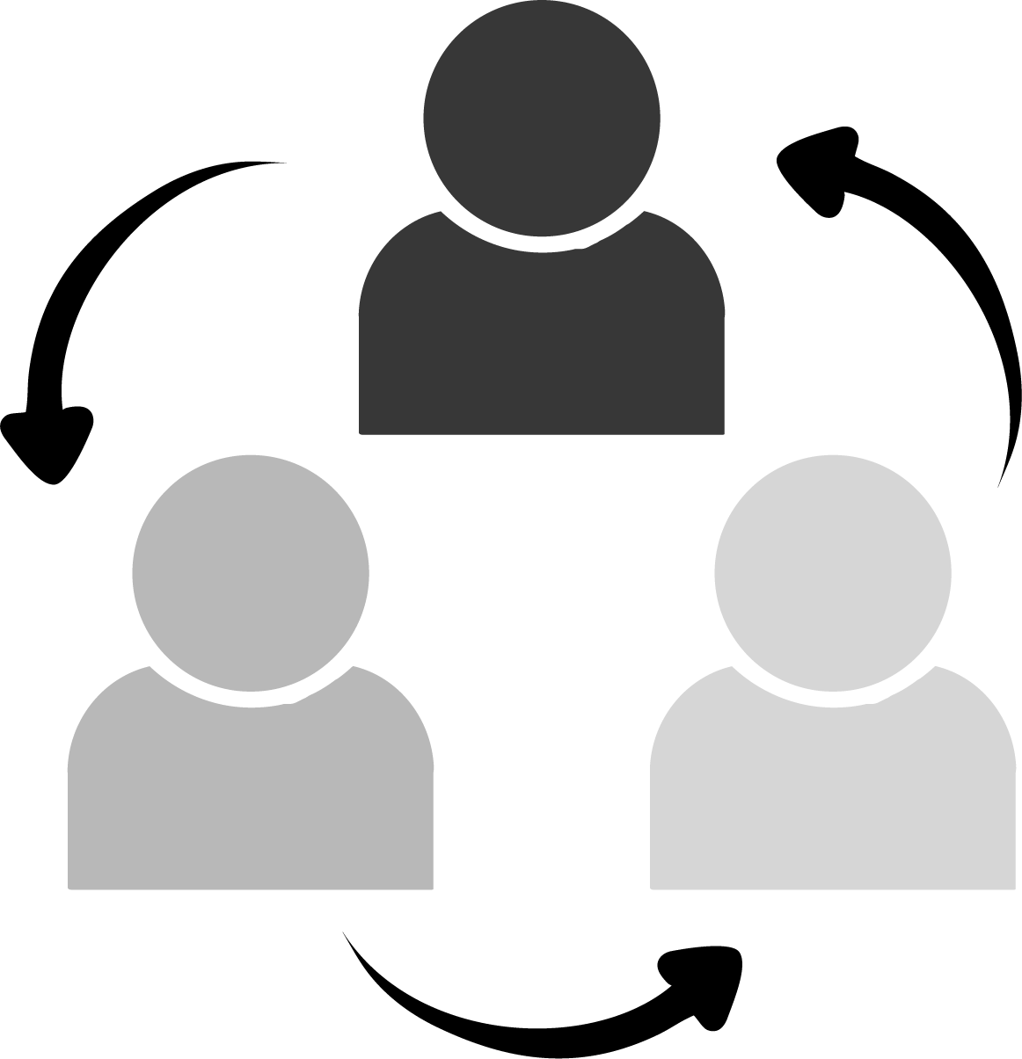
How Bad Can It Be?
My Insurance Will Cover Me, Won’t It?
Insurance companies are in the business to make money, NOT pay out policy claims.
A few years ago, cyber insurance carriers were keeping 70% of premiums as profit and only paying out 30% in claims. Fast forward to today and those figures are turned upside-down, causing carriers to make drastic changes in how
cyber-liability insurance is acquired, and coverages paid.
For starters, even getting a basic cyber-liability or crime policy today may require you to prove you have certain security measures in place, such as multi-factor authentication, password management, endpoint protection and tested and proved data backup solutions.
Insurance carriers want to see phishing training and cybersecurity awareness training in place, and some will want to see a WISP and/or a Business Continuity Plan from your organization. Depending on the carrier, your specific situation and the coverage you’re seeking, the list can be longer.
But the biggest area of RISK that is likely being overlooked in your business is the actual enforcement of critical security protocols required for insurance coverage and compliance with data protection laws. Insurance carriers can (and will) deny payment of your claim if you failed to implement the security measures required to secure coverage. When a breach happens, they will investigate how it happened and whether you were negligent before paying out.
You cannot say, “I thought my IT company was doing this!” as a defense. Your IT company will argue they were not involved in the procurement of the policy and did not warranty your security (none will; check out your contract with them). They might show evidence of you refusing to purchase advanced security services from them to further distance them from any responsibility. And if you haven’t been documenting the steps you’ve taken to secure your network and prove that you were not “willfully negligent,” this gigantic expensive nightmare will land squarely on your shoulders to pay.
It’s NOT Just Cybercriminals Who Are The Problem
Most business owners erroneously think cybercrime is limited to hackers based in China or Russia, but the evidence is overwhelming that disgruntled employees, both of your company and your vendors, can cause significant losses due to their knowledge of your organization and access to your data and systems. What damage can they do?
They leave with YOUR company’s files, client data and confidential information stored on personal devices, as well as retaining access to cloud applications, such as social media sites and file-sharing sites (Dropbox or OneDrive, for example), that your IT department doesn’t know about or forgets to change the password to. In fact, according to an in-depth study conducted by Osterman Research, 69% of businesses experience data loss due to employee turnover and 87% of employees who leave take data with them. What do they do with that information? Sell it to competitors, BECOME a competitor or retain it to use at their next job.

Slide 8
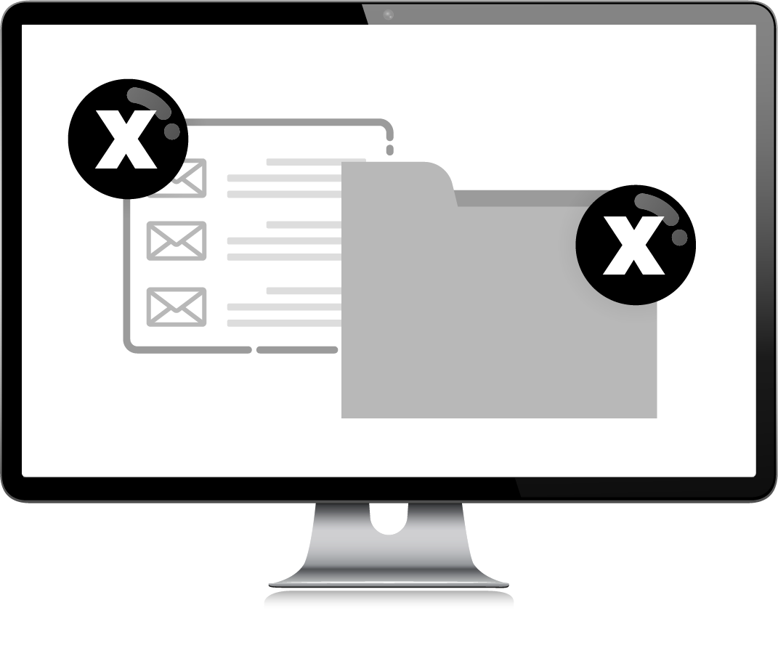
Funds, inventory, trade secrets, client lists and HOURS stolen. There are dozens of sneaky ways employees steal, and it’s happening a LOT more than businesses care to admit. According to the website Statistic Brain, 75% of all employees have stolen from their employers at some point. From stealing inventory to check and credit card fraud, your hard-earned money can easily be stolen over time in small amounts that you never catch. Here’s the most COMMON way they steal: They waste HOURS of time on your dime to do personal errands, shop, play games, check social media feeds, gamble, read the news and a LONG list of non-work-related activities. Of course, YOU are paying them for a 40-hour week, but you might only be getting half of that. Then they complain about being “overwhelmed” and “overworked.” They tell you, “You need to hire more people!” so you do. All of this is a giant suck on profits if you allow it. Further, if your IT company is not monitoring what employees do and limiting what sites they can visit, they could do things that put you in legal jeopardy, like downloading illegal music and video files, visiting adult content websites, gaming and gambling – all these sites fall under HIGH RISK for viruses and phishing scams.
They DELETE everything. A common scenario: An employee is fired or quits because they are unhappy with how they are being treated – but before they leave, they permanently delete ALL their e-mails and any critical files they can get their hands on. If you don’t have that data backed up, you lose it ALL. Even if you sue them and win, the legal costs, time wasted on the lawsuit and on recovering the data, not to mention the aggravation and distraction of dealing with it all, are all greater costs than what you might get awarded if you win the lawsuit, might collect in damages.
They become a PAID whistleblower for the government. For example, complaints filed for HIPAA violations on medical practices primarily come from two sources: 1. An actual cyber-attack happening, or 2. Whistleblowers inside the organization. More specifically, disgruntled patients and employees, not government auditors. Employees, vendors and even patients/clients can be financially rewarded for reporting YOU and be protected under a Safe Harbor law. Ambulance chasing attorneys know this and are advertising to take whistleblower cases on Google (just do a quick search for “Medicaid fraud whistleblower reward” and look at the ads that come up from law firms). There’s even a website, www.CorporateWhistleBlower.com that promotes, “Get Rewarded For What You Know,” encouraging people to come forward for Medicare fraud or companies over-billing or defrauding the government. This is just the tip of the iceberg coming for ALL industries as state and federal governments enact more cybersecurity protection laws.
Look at the above list. Do you really think this can’t happen to you?
Then there’s the threat of vendor theft. Your payroll, HR and accounting firm have direct access to highly confidential information and a unique ability to commit fraud. THEIR employees, not just the leadership team, can steal money, data and confidential information. All it takes is a part-time employee – perhaps hired to assist in data entry during tax season, and who is not being closely supervised or is working from home on routine tasks with your account – to decide to make a little money on the side by selling data or siphoning funds from your account.
Schedule Your Free, Cybersecurity Risk Assessment Today!
Visit www.getadvantage.com or call our office at 443-319-4070.

Slide 9
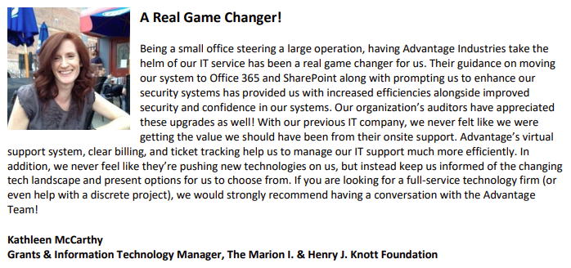
What Do Other Customers In Maryland Say?
Schedule Your Free Cybersecurity Risk Assessment Today!
Visit www.getadvantage.com or call our office at 443-319-4070.

Slide 10
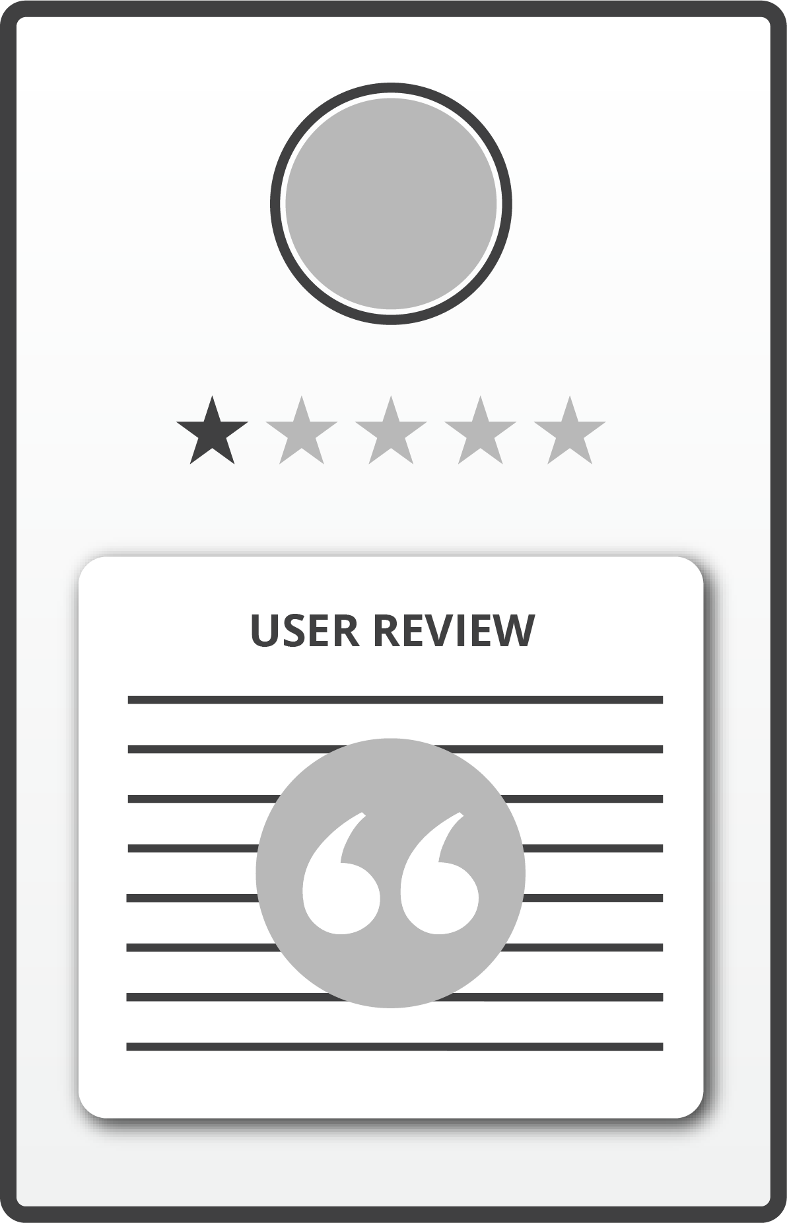
What’s worse than a data breach? Trying to cover it up. Companies like Yahoo! are learning that lesson the hard way, facing multiple class-action lawsuits for NOT telling their users immediately when they discovered they were hacked. With dark-web monitoring and forensics tools, WHERE data gets breached is easily traced back to the company and website, so you cannot hide it. When it happens, do you think your clients will rally around you? Have sympathy? News like this travels fast on social media. They will demand answers: HAVE YOU BEEN RESPONSIBLE in putting in place the protections outlined in this report, or will you have to tell your clients, “Sorry, we got hacked because we didn’t think it would happen to us,” or “We didn’t want to spend the money”? Is that going to be sufficient to pacify them?
Exactly How Can Your Company Be Damaged By Cybercrime? Let Us Count The Ways:
1.
Reputational Damages:
2.
Government Fines, Legal Fees, Lawsuits:
Breach notification statutes remain one of the most active areas of the law. Right now, several senators are lobbying for “massive and mandatory” fines and more aggressive legislation pertaining to data breaches and data privacy. The courts are NOT in your favor if you expose client data to cybercriminals. Don’t think for a minute that this only applies to big corporations: ANY small business that collects customer information also has important obligations to its customers to tell them if they experience a breach. In fact, 47 states and the District of Columbia each have their own data breach laws – and they are getting tougher by the minute.
If you’re in health care or financial services, you have additional notification requirements under the Health Insurance Portability and Accountability Act (HIPAA), the Securities and Exchange Commission (SEC) and the Financial Industry Regulatory Authority (FINRA). Among other things, HIPAA stipulates that if a health care business experiences a breach involving more than 500 customers, it must notify a prominent media outlet about the incident. The SEC and FINRA also require financial services businesses to contact them about breaches, as well as any state regulating bodies. With all the new laws being passed, there is a very good chance you are NOT compliant – what HAS your IT company told you about this?
Schedule Your Free Cybersecurity Risk Assessment Today!
Visit www.getadvantage.com or call our office at 443-319-4070.

Slide 11
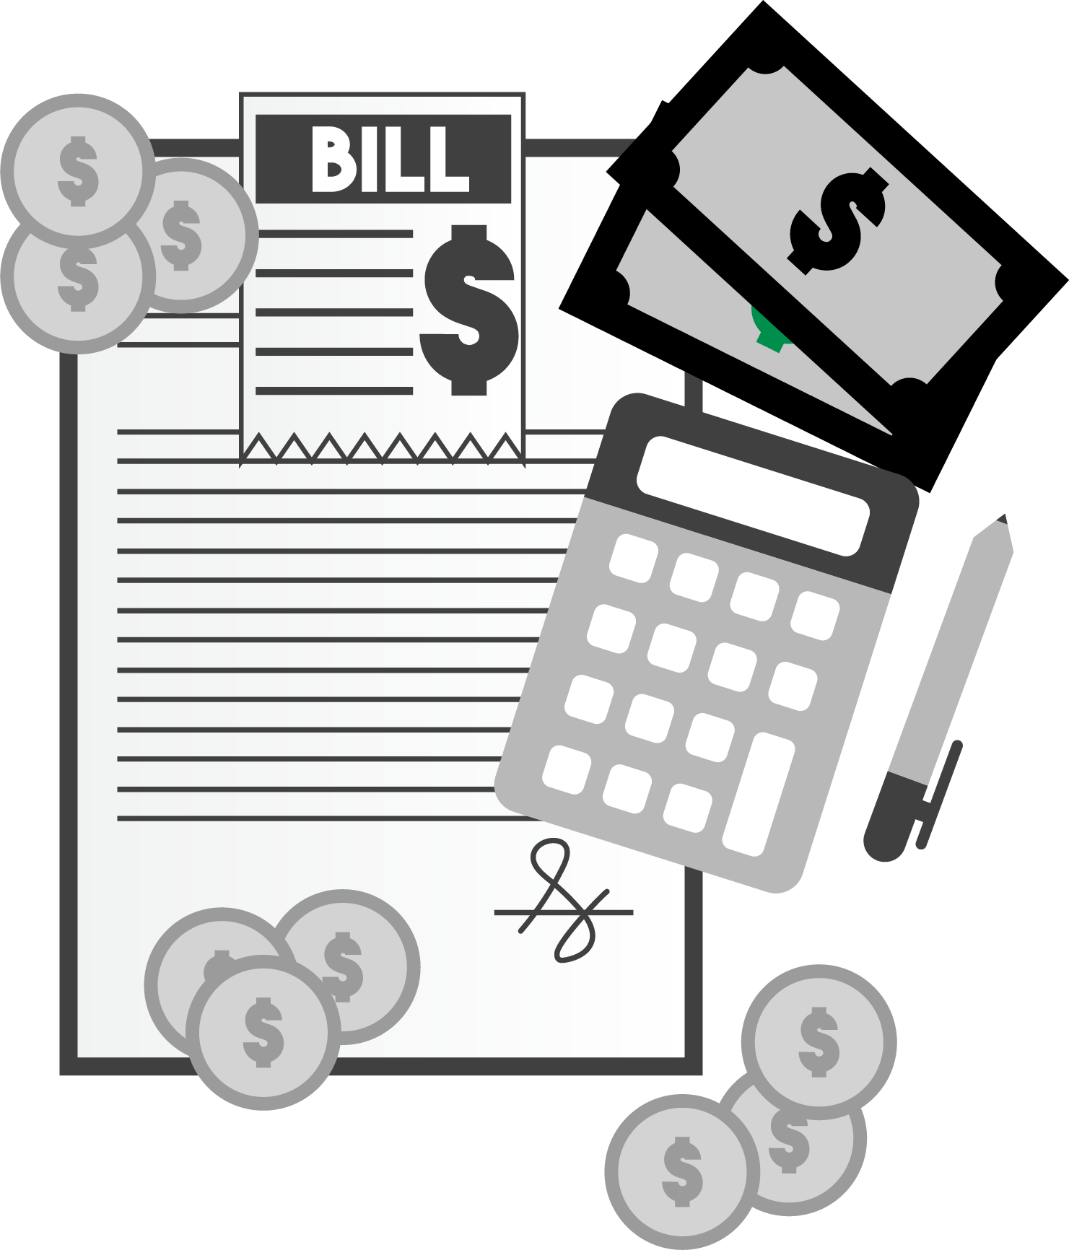
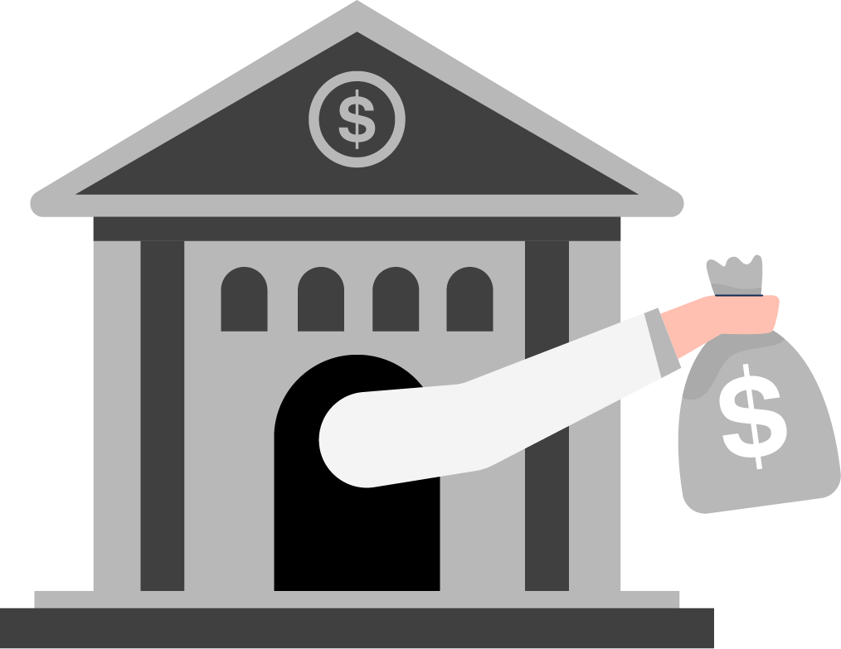
ONE breach, one ransomware attack, one rogue employee can create HOURS of extra work for staff who are already maxed out when things are going well. Then there’s business interruption and downtime, backlogged work delivery for your current clients. Loss of sales. Forensics costs to determine what kind of hack attack occurred, what part of the network is/was affected and what data was compromised. Emergency IT restoration costs for getting you back up, if that’s even possible. In some cases, you’ll be forced to pay the ransom and maybe – just maybe – they’ll give you your data back. Then there are legal fees and the cost of legal counsel to help you respond to your clients and the media. Cash flow will
3.
Cost, After Cost, After Cost:
be significantly disrupted, budgets blown up. Some states require companies to provide one year of credit-monitoring services to consumers affected by a data breach, and more are following suit.
According to the Cost of Data Breach Study conducted by Ponemon Institute, the average cost of a data breach is $225 per record compromised, after factoring in IT recovery costs, lost revenue, downtime, fines, legal fees, etc. How many client records do you have? Employees? Multiply that by $225 and you’ll start to get a sense of the costs to your organization. [NOTE: Health care data breach costs are the highest among all sectors.]
4.
Bank Fraud:
If your bank account is accessed and funds stolen, the bank is NOT responsible for replacing those funds. Take the true story of Verne Harnish, CEO of Gazelles, Inc., a very successful and well-known consulting firm, and author of the best-selling book Mastering The Rockefeller Habits. Harnish had $400,000 taken from his bank account when hackers were able to access his PC and intercept e-mails between him and his assistant. The hackers, who are believed to be based in China, sent an e-mail to his assistant asking her
to wire funds to 3 different locations. It didn’t seem strange to the assistant because Harnish was then involved with funding several real estate and investment ventures. The assistant responded in the affirmative, and the hackers, posing as Harnish, assured her that it was to be done. The hackers also deleted his daily bank alerts, which he didn’t notice because he was busy running the company, traveling and meeting with clients. That money was never recovered, and the bank is not responsible. Everyone wants to believe “Not MY assistant, not MY employees, not MY company” – but do you honestly believe that your staff is incapable of making a single mistake? A poor judgment? Nobody believes they will be in a car wreck when they leave the house every day, but you still put the seat belt on. You don’t expect a life-threatening crash, but that’s not a reason to not buckle up. What if? Claiming ignorance is not a viable defense, nor is pointing to your outsourced IT company to blame them. YOU will be responsible, and YOUR company will bear the brunt.
5.
Using YOU As The Means To Infect Your Clients:
Some hackers don’t lock your data for ransom or steal money. Often, they use your server, website or profile to spread viruses and/or compromise other PCs. If they hack your website, they can use it to relay spam, run malware, build SEO pages or promote their religious or political ideals. (Side note: This is why you also need advanced endpoint security, spam filtering, web gateway security, SIEM and the other items detailed in this report, but more on those in a minute.) Are you okay with that happening?

Slide 12
It’s very possible that you are being ill-advised by your current IT company. What have they recently told you about the rising tsunami of cybercrime? Have they recently met with you to discuss new protocols, new protections and new systems you need in place TODAY to stop the NEW threats that have developed over the last few months? If not, there could be several reasons for this. First, and most common, they might not know HOW to advise you, or even that they should. Many IT companies know how to keep a computer network running but are completely out of their league when it comes to dealing with the advanced cybersecurity threats we are seeing recently. Second, they may be “too busy” themselves to truly be proactive with your account – or maybe they don’t want to admit the service package they sold you has become OUTDATED and inadequate compared to far superior
You May Want To Believe You’re “Safe” But Are You Sure?
solutions available today. At industry events, I’m shocked to hear other IT companies say, “We don’t want to incur that expense,” when talking about new and critical cybersecurity tools available. Their cheapness CAN be your demise.
And finally, NOBODY (particularly IT guys) likes to admit they are out of their depth. They feel compelled to exaggerate their ability to avoid being fired. To be fair, they might have you covered and be on top of it all. So how do you know?
Is Your Current IT Company Doing Their Job? Take The Quiz On The Next Page To Find Out
If your current IT company does not score a “Yes” on every point, they are NOT adequately protecting you. Don’t let them “convince” you otherwise and DO NOT give them a free pass on any one of these critical points.
Further, it’s important that you get verification on the items listed. Simply asking, “Do you have insurance to cover us if you make a mistake?” is good, but getting a copy of the policy or other verification is critical. When push comes to shove, they can deny they told you.
Schedule Your Free Cybersecurity Risk Assessment Today!
Visit www.getadvantage.com
or call our office at 443-319-4070

Slide 13
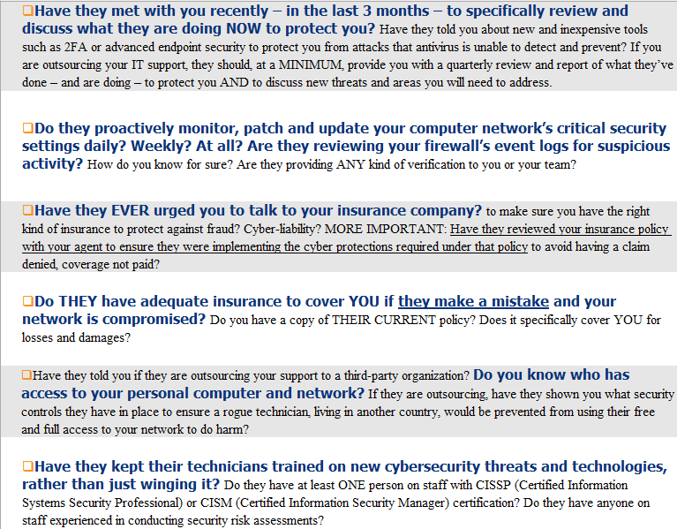
If your current IT company does not score a “YES” on every point, they are NOT adequately protecting you.

Slide 14
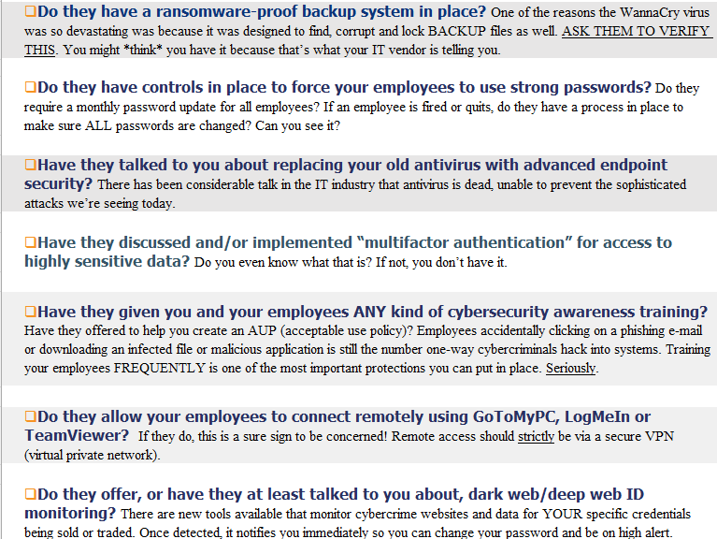

Slide 15
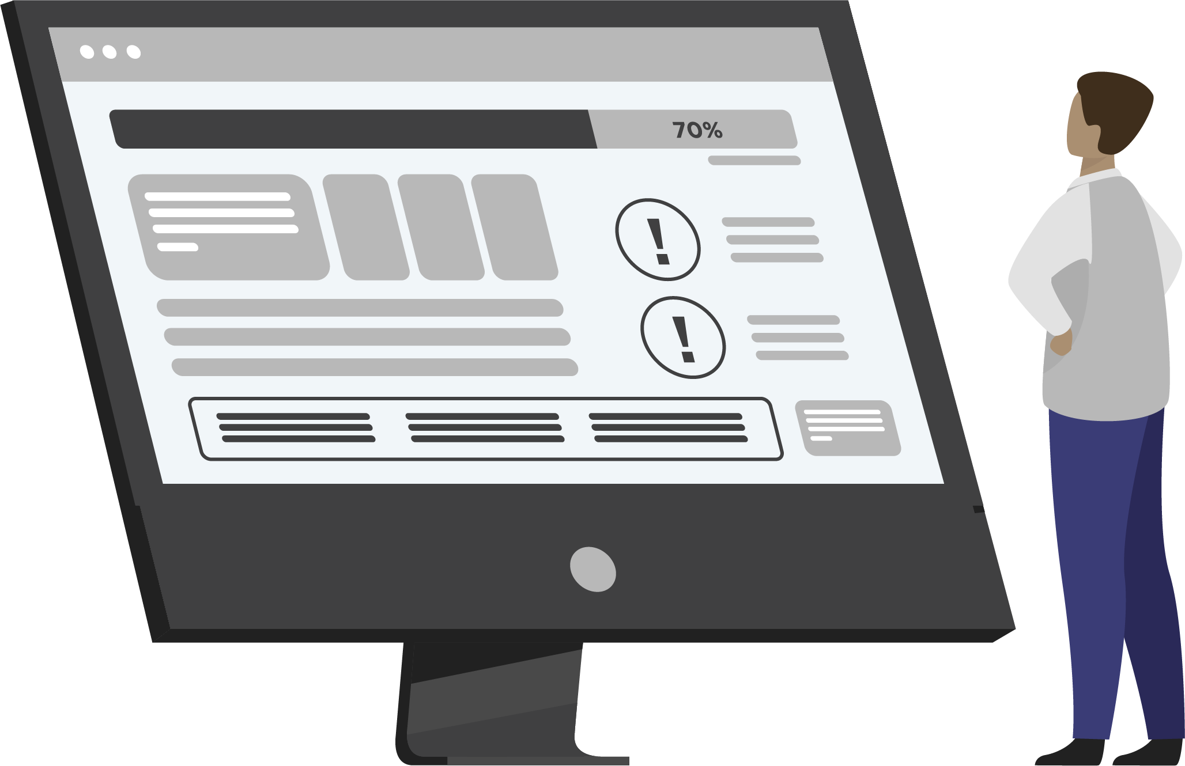
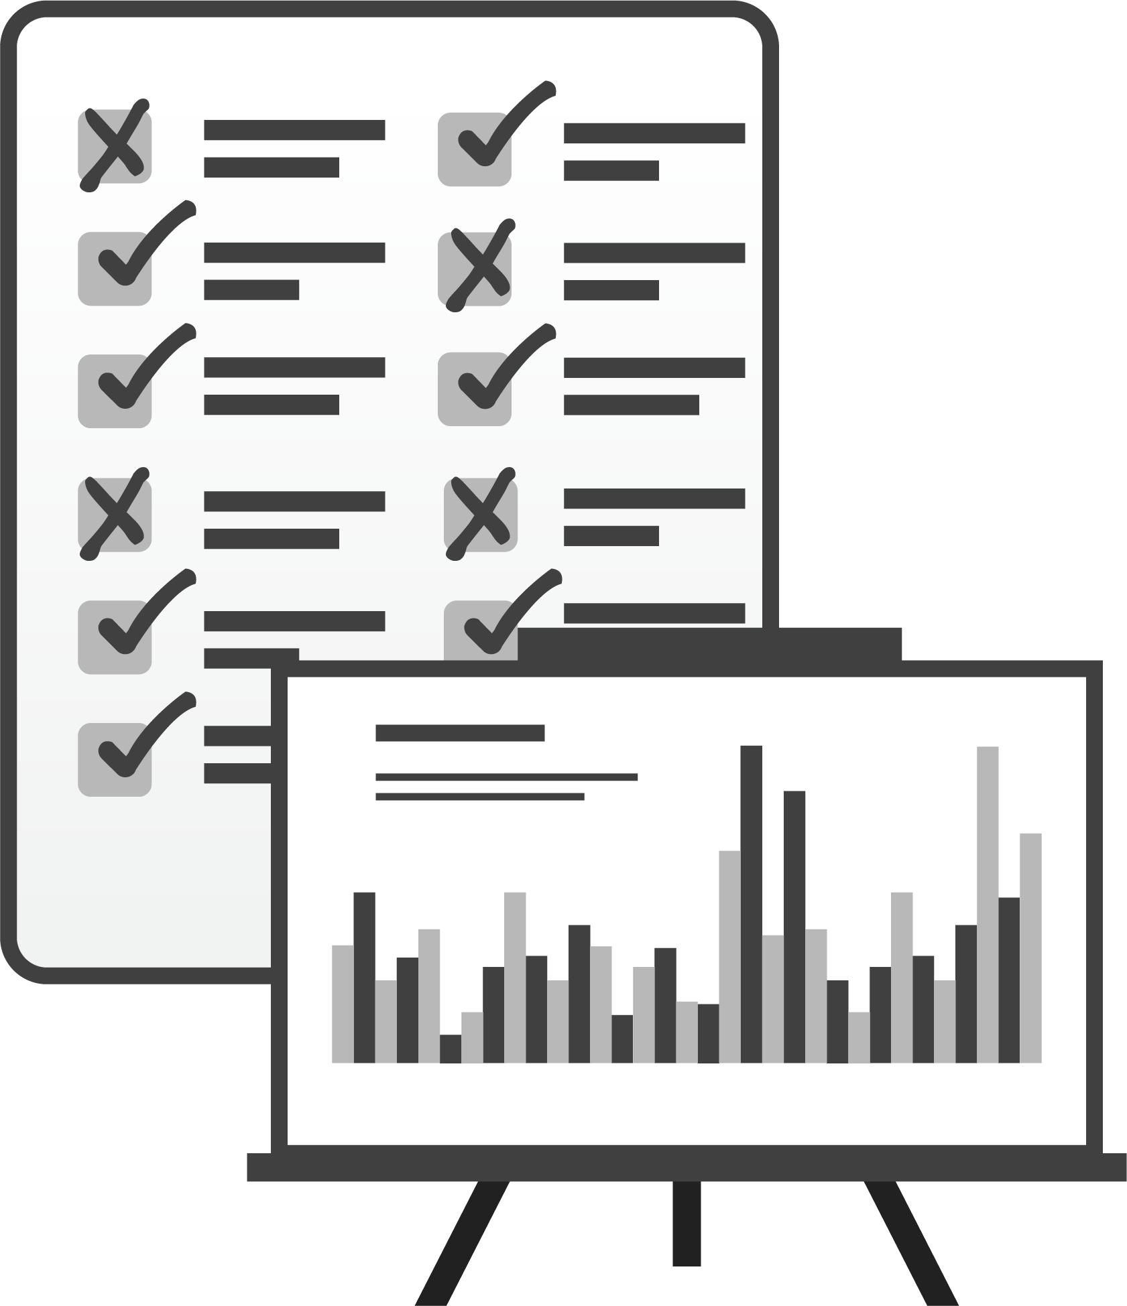
A security assessment is exactly what it sounds like – it’s a process to review, evaluate and “stress test” your company’s network to uncover loopholes and vulnerabilities BEFORE a cyber-event happens. Just like a cancer screening, a good assessment can catch problems while they’re small, which means they will be a LOT less expensive to fix, less disruptive to your organization AND give you a better chance of surviving a cyber-attack.
A Preemptive Independent Risk Assessment: The ONLY Way You Can Really Be Sure
An assessment should always be done by a qualified third party, NOT your current IT team or company; fresh eyes see things hidden, even in plain sight, from those looking at it daily.
You want a qualified “Sherlock Holmes” investing on YOUR behalf who is not trying to cover up inadequacies or make excuses, bringing to you a confidential report you can use before others find dirty laundry and air it in harmful ways.
Our Free Cybersecurity Risk Assessment Will Give You The Answers You Want, The Certainty You Need
For a limited time, we are offering to give away a Free Cybersecurity Risk Assessment to a select group of businesses. This is entirely free and without obligation. EVERYTHING WE FIND AND DISCUSS WILL BE STRICTLY CONFIDENTIAL.
This assessment will provide verification from a qualified third party on whether or not your current IT company is doing everything they should to keep your computer network not only up and running, but SAFE from cybercrime.
Here’s How It Works: At no cost or obligation, one of my lead consultants and I will come to your office and conduct a non-invasive, CONFIDENTIAL investigation of your computer network, backups and security protocols. Your current IT company or guy DOES NOT NEED TO KNOW we are conducting this assessment. Your time investment is minimal: one hour for the initial meeting and one hour in the second meeting to go over our Report Of Findings.
Schedule Your Free Cybersecurity Risk Assessment Today!
Visit www.getadvantage.com or call our office at 443-319-4070.

Slide 16
When This Risk Assessment IS Complete, You Will Know:
If you and your employees’ login credentials are being sold on the dark web. We will run a scan on your company, right in front of you, in the privacy of your office if you prefer (results will NOT be e-mailed or otherwise shared with anyone but you). It’s RARE that we don’t find compromised credentials – and I can guarantee what we find will shock and alarm you.
If your IT systems and data are truly secured from hackers, cybercriminals, viruses, worms and even sabotage by rogue employees.
If your current backup would allow you to be back up and running again fast if ransomware locked all your files. In 99% of the computer networks, we’ve reviewed over the years, the owners were shocked to learn the backup they had would NOT survive a ransomware attack.
If employees truly know how to spot a phishing e-mail. We will put them to the test. We’ve never seen a company pass 100%. Not once.
If your IT systems, backups and [Policies] are in sync with compliance requirements for HIPAA, GLBA, SOX, your Cyber Insurance and using best practices to ensure that you have the best defenses against a breach and if an event does happen that you’re in the best possible position to get paid by your cyber insurance carrier.
If we DO find problems…overlooked security loopholes, inadequate backups, credentials that have been compromised, out-of-date firewall and antivirus software and (often) active malware…on one or more of the PCs in your office, we will propose an Action Plan to remediate the situation that you can have us implement for you if you choose.
Again, I want to stress that EVERYTHING WE DISCUSS AND DISCOVER WILL BE STRICTLY CONFIDENTIAL.
Why Free?
Frankly, we want the opportunity to be your IT company. We know we are the most competent, responsive and trusted IT services provider to small businesses in Maryland.
However, I also realize there’s a good chance you’ve been burned, disappointed and frustrated by the complete lack of service and the questionable advice you’ve gotten from other IT companies in the past. In fact, you might be so fed up and disgusted with being “sold” and underserved that you don’t trust anyone. I don’t blame you.
That’s why this assessment is completely and entirely free. Let us earn your trust by demonstrating our expertise. While we would love the opportunity to be your IT company, we will come in with no expectations and only look to provide you with fact-based information so you can make a quality, informed decision – and we’ll ONLY discuss the option of becoming your IT company if the information we share makes sense and you want to move forward. No hard sell. No gimmicks and no tricks.
Schedule Your Free Cybersecurity Risk Assessment Today!
Visit www.getadvantage.com or call our office at 443-319-4070.

Slide 17
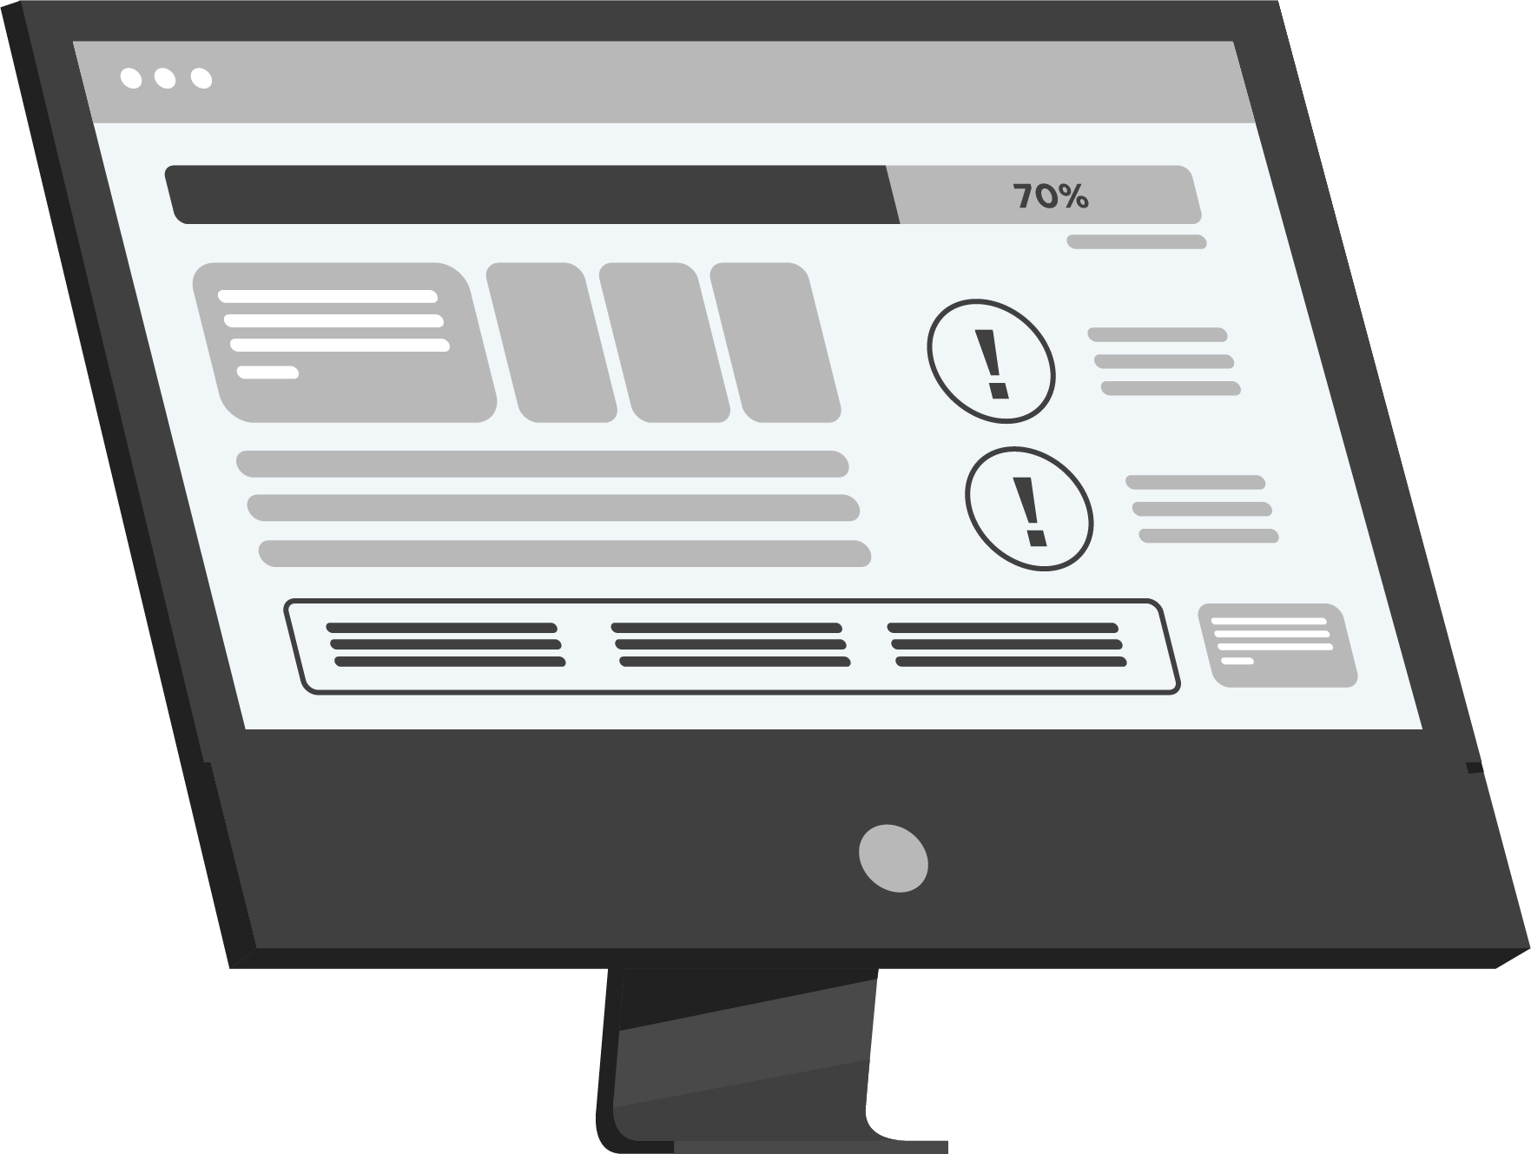
Please…Do NOT Just Shrug This Off
(What To Do Now)
I know you are extremely busy and there is enormous temptation to discard this, shrug it off, worry about it “later” or dismiss it altogether. That is, undoubtedly, the easy choice…but the easy choice is rarely the RIGHT choice. This I can guarantee: At some point, you WILL HAVE TO DEAL WITH A CYBERSECURITY EVENT.
Hopefully, you’ll be brilliantly prepared for it and experience only a minor inconvenience at most. But if you wait and do NOTHING, I can practically guarantee there will be a far more costly, disruptive and devastating attack that will happen to your business.
You’ve spent a lifetime working hard to get where you are today. Don’t let some lowlife thief operating outside the law in another country get away with taking that from you. And certainly don’t “hope” your IT guy has you covered.
Get the facts and be certain you are protected.
Contact Us And Schedule Your Free, CONFIDENTIAL Cybersecurity Risk Assessment Today!
Visit www.getadvantage.com.
Or feel free to also reach out to me direct
at 443-319-4070
Dedicated to serving you,
Keith Heilveil
Web: www.getadvantage.com
E-mail: keithh@getadvantage.com
Direct: 443-319-4070
P.S. – When I talked to other IT professionals like myself and the CEOs who have been hacked or compromised, almost all of them told me they thought their IT guy “had things covered.”
I’m also very connected with other IT firms across the country to “talk shop” and can tell you most IT guys have never had to deal with the enormity and severity of attacks happening in the last few months. That’s why it’s VERY likely your IT guy does NOT have you “covered” and you need a preemptive, independent risk assessment like the one I’m offering in this letter.
As a CEO myself, I understand that you have to delegate and trust, at some level, that your employees and vendors are doing the right thing – but it never hurts to validate that they are. Remember, it’s YOUR reputation, YOUR money, YOUR business that’s on the line. THEIR mistake is YOUR nightmare.

Slide 18
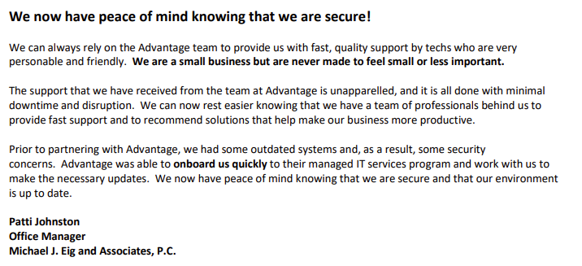
Here Are Just A Few Other Business Leaders We’ve Helped:
Client Photo Here
(Ideally In Grayscale)
Outline the story of the testimonial here. Remember, all testimonials should validate a claim you are making and/or overcome an objection.
“Testimonial Copy”
– Name, Location
Client Photo Here
(Ideally In Grayscale)
Client Photo Here
(Ideally In Grayscale)
Schedule Your Free Cybersecurity Risk Assessment Today!
Visit www.getadvantage.com or call our office at 443-319-4070.

